Slide 1
LIBRARY MANAGEMENT SYSTEM
Presented by :
Muhammad Zubair (2020-cs-601)
MUHAMMAD HUZAIFA (2020-cs-606)
HAFIZ ABDUL-RAHMAN (2020-cs-624)
Muhammad Qasim (2020-cs-643)
Presented To :
Sir Waqas ali

Slide 2
Outline
Overview
User Characteristics
Software Configuration
Login Page
Home Page
User
Add/View/Update/Delete User
Book
Add/View/Update/Delete Book
Issue Book
Receive Book
Fine
Charts

Slide 3
Overview
In this project we will describe why we choose that topic, scope of this system, problem that currently face by Library Management System and what betterment we make in this project and make it effective.
The project “Library Management System “is a software for monitoring and controlling the transactions in a library. With the ever-increasing sea of information, this modern function of library is becoming very complex and tedious to handle manually. The main focus of this project is to lessen human effort and encourage efficient record keeping.
So after conducting the feasibility study we decided to make the manual Library management system to be computerized. We tried our best to make our project Which shall provide user friendly interface.

Slide 4
User Characteristics
Administration Side :Following are the sub modules perform by admiration side.
Add Students Detail
Add Books Detail
Search User/Book
Issue Book to any Student
Receive Returned Book
Declaring Fine to Student
Providing Charts for Data Display
Maintaining Student/Book details
Sending E-mail to the registered Students

Slide 5
Software Configuration
Operating System : Windows
RAM : 4 GB or more
Software : Visual Studio 2022
Database : MySQL
Process : Intel core-i3 or more
Language : C#
Hard Disk : 250 GB or more

Slide 6
Login Page
This login page is for admin authentication which includes.
Username : Username will be verify from the database .
Password : Password will be verify from the database.
Login Button : Clicking on Login button will perform authentication and let admin to enter in software.
Correct Username and password is necessary for successfully login. If user write username and password in different cases then admin will not be authenticate properly. Admin has to write the exact sentence case written in database.

Slide 7
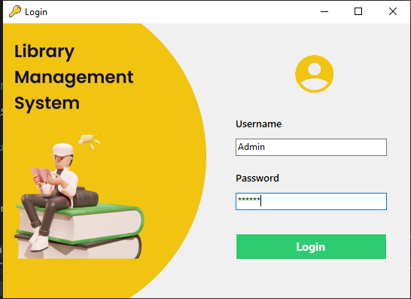
Login Page(Continue..)

Slide 8
Home Page
This Home page is to perform multiple functionalities which includes.
User : User Button is to Add/View/Update/Delete User.
Book : Book Button is to Add/View/Update/Delete Book.
Issue Book : Issue Book Button is for issue and re-issue Book .
Receive Book : Receive Book Button is to receive books return by users.
View Chart : View Chart is to view issuance and threshold chart.
Fine : Due to this feature Admin can put fine to students on some cases.

Slide 9
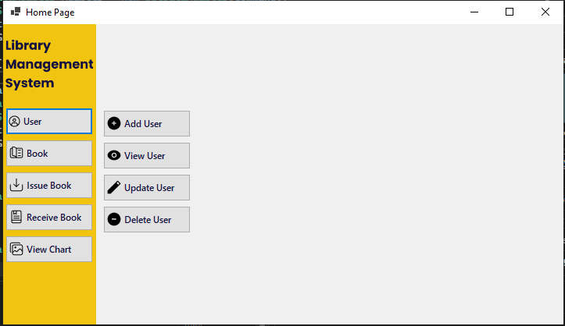
Home Page(Continue..)

Slide 10
User Functionality: Hafiz Abdul Rehman
Functionalities:
We have implemented various functionalities in this project. From my side of contribution, I have implemented these functionalities About Users:
Add User
View User
Update User
Delete User

Slide 11
Add User
Add User Functionality:
User Provide His Name, ID, Phone # and E-mail Address. Admin Enter His Name, ID, Phone # and E-mail Address then, He Can Add the User by Clicking the Add User Button.

Slide 12
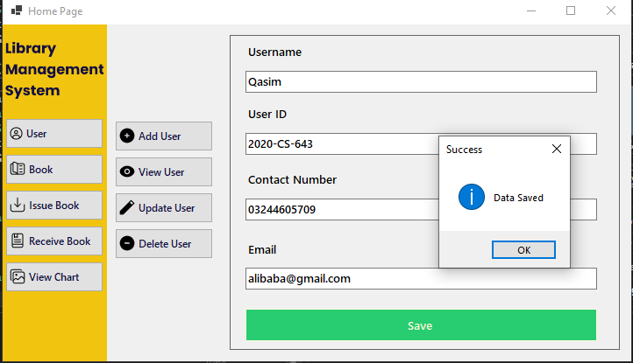
Add User(Continue..)

Slide 13
View User
View User Functionality:
Admin can View The User By Providing The User's ID and User is Display if He Is, On By Clicking The Search Button.

Slide 14
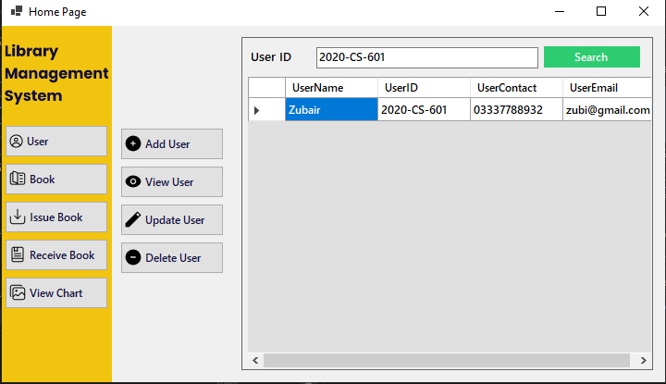
View User(Continue..)

Slide 15
Update User
Update User Functionality:
Admin can Update The User By Providing The User's ID and user is display if he is , Admin can Update User's Name , User's Phone #, And E-mail Address By Clicking The Update Button.

Slide 16
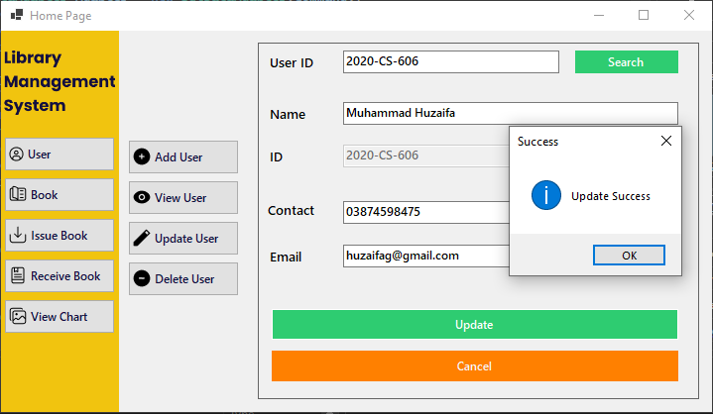
Update User(Continue..)

Slide 17
Delete User
Delete User Functionality:
Admin can Delete The User By Providing The User's ID and User is display if he is , Admin can Delete The User By Clicking The Delete Button.

Slide 18
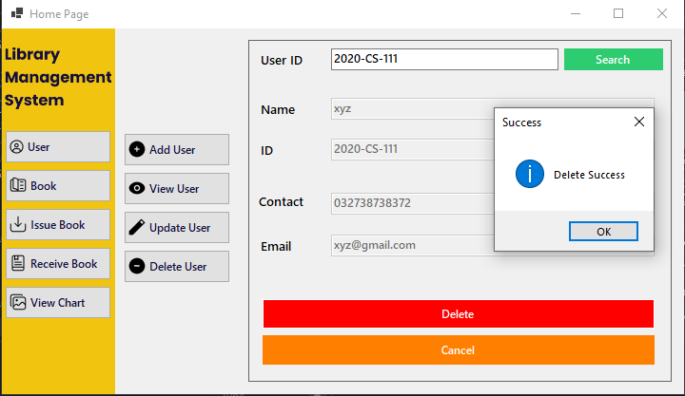
Delete User(Continue..)

Slide 19
Book Functionality: Muhammad Qasim
Functionalities:
We have implemented various functionalities in this project. From my side of contribution, I have implemented Complete Book functionalities which includes which includes:
Add Book
View Book
Update Book
Delete Book

Slide 20
Add Book
Add Book Functionality:
Admin Provides the Complete Information of the Book which he wants to Add in Database. Book Information Includes Book-Name, ISBN, Published Date, Category, Quantity and Author-Name. Note that here ISBN and Published Date are Primary Keys. As Admin Add any New Book an Email will automatically send to all that students who are registered in this Library Management System. That Email will contain New Book Information

Slide 21
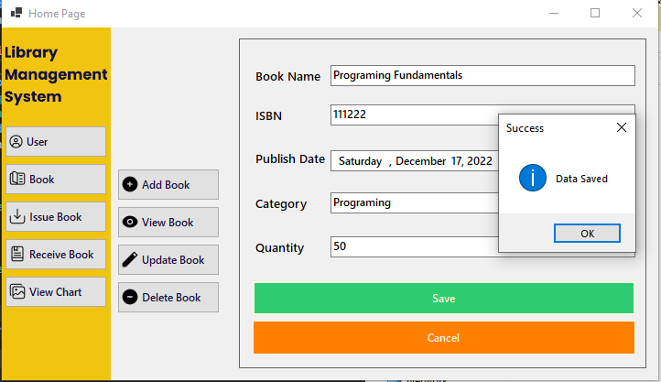
Add Book (Continue..)

Slide 22
View Book
View Book Functionality:
Admin can See those Books that Has Added or Registered in Database. Admin can View Book by three different ways.
By ISBN
By Name
By Category
Admin has to write one of them and Click on Search Button and if Book has Added then it's Information will display in a Row.

Slide 23
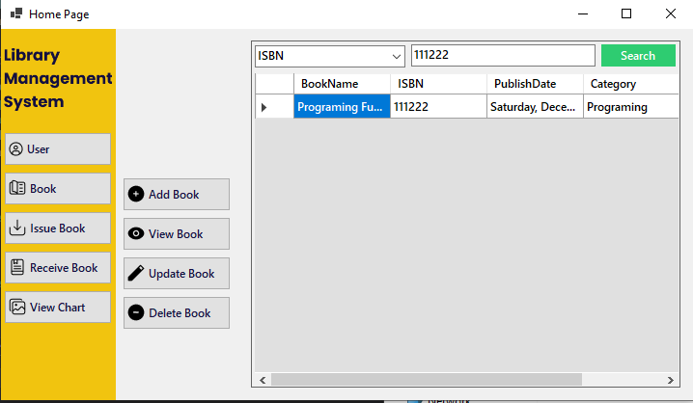
View Book (Continue..)

Slide 24
Update Book
Update Book Functionality:
Admin can also Update Book Data using Book ISBN code. For Updating Book remember that Admin can't change or update Book ISBN and Published Date, because these two are the Primary Keys. On the other side Admin can make changes to other attributes like Book-Name, Category, Quantity and Author-Name.

Slide 25
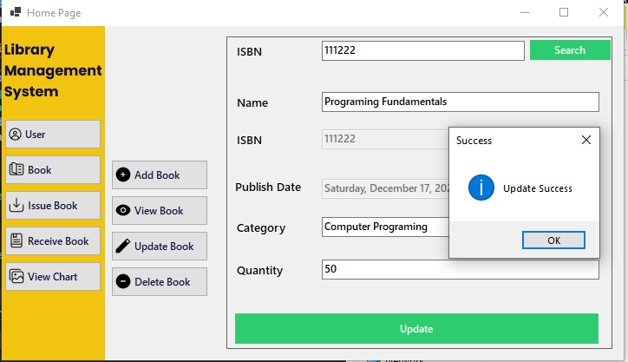
Update Book (Continue..)

Slide 26
Delete Book
Delete Book Functionality:
Admin can Delete Book Data using Book ISBN code. For Deleting a Book Admin has to Write ISBN of that Book which he wants to delete. As Admin write ISBN on search bar, Book Information will display with a Delete Button there. If Admin click on Delete Button complete Data of that Book will be erased from Database.

Slide 27
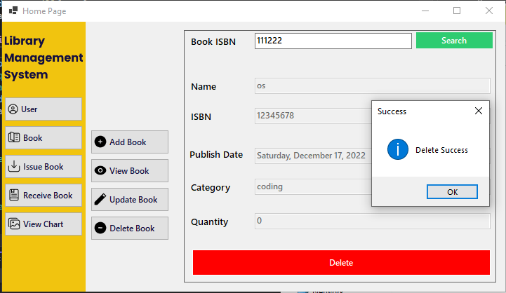
Delete Book (Continue..)

Slide 28
Issue Book Functionality: Muhammad Huzaifa
Functionalities:
We have implemented various functionalities in this project. From my side of contribution, I have implemented two functionalities:
Issue Book to User
Issuance Book Chart

Slide 29
Issue Book to User
Issue Book to User Functionality:
We have implemented all functionalities on admin side. Admin can issue to user. Following are some conditions:
Maximum Three Books issued to one user at a time.
User can Re-Issue Book Before return date.
Admin can see the count of Issued, Returned and Fine of each user by entering the User-ID.

Slide 30
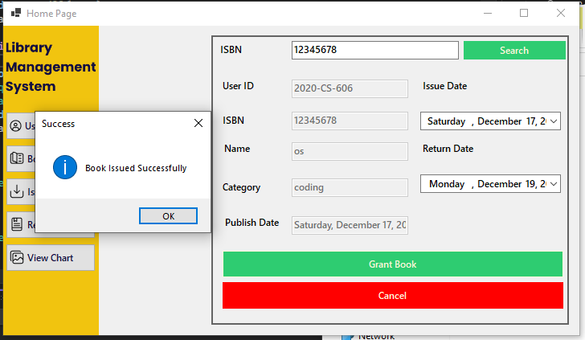
Issue Book (Continue..)

Slide 31
Issuance Book Chart
Issuance Book Chart Functionality
This functionality shows the Issuance record of books. Graph shows that given book is issued how many times. I have implemented this graph in C#. This graph is for the simplicity of admin that admin can see all records of books that are issued.

Slide 32
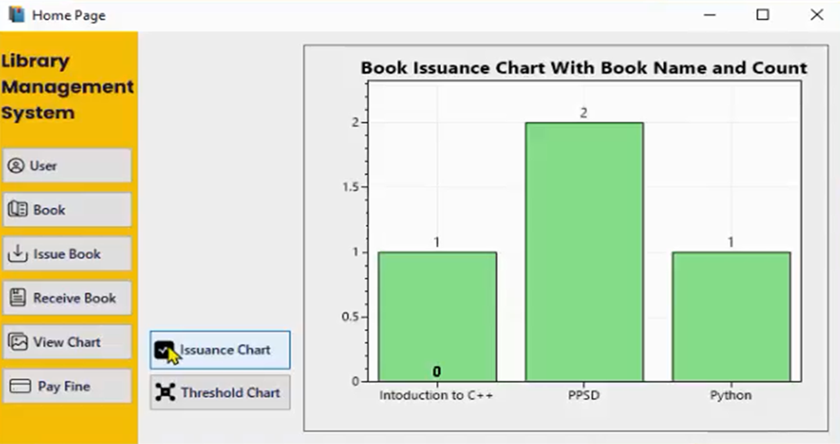
Issuance Chart(Continue..)

Slide 33
Return Book Functionality: Muhammad Zubair
Functionalities:
We have implemented various functionalities in this project. From my side of contribution, I have implemented these three functionalities:
Receive Book Functionality
Threshold Chart Functionality
Pay Fine Functionality

Slide 34
Receive Book from User
Return Book Functionality:
User Provide His ID if He Wants to Return the Book That Has Been Previously Issued to Him/Her. Admin Enter his User ID and Search for His Record. If the Record is Found, then He Can Return the Book by Clicking Return Book Button.

Slide 35
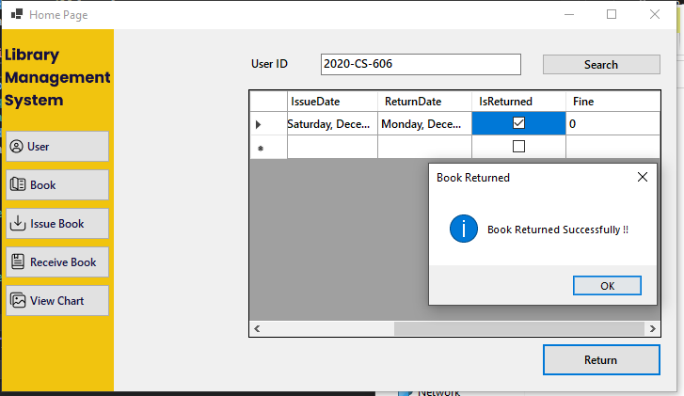
Return Book (Continue..)

Slide 36
Fine On Student
Fine Functionality:
Admin can also Clear the Fine of the User. The user Just Needs to Provide His User ID with a Specified Fine Amount in Cash. Admin Takes Amount and Search for User Data, If Found then Clear His Fine.

Slide 37
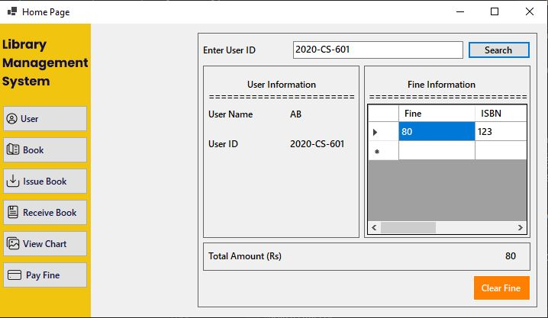
Fine On Student (Continue..)

Slide 38
Threshold Chart
Threshold Chart Functionality
Admin can see those Book books That Have Limited Quantity. We Have Set the Threshold Amount of 10. The Lollipop Like Graph Will Be Displaying a List of All Books Having a Quantity of Less than 10 in a Graphical Way

Slide 39
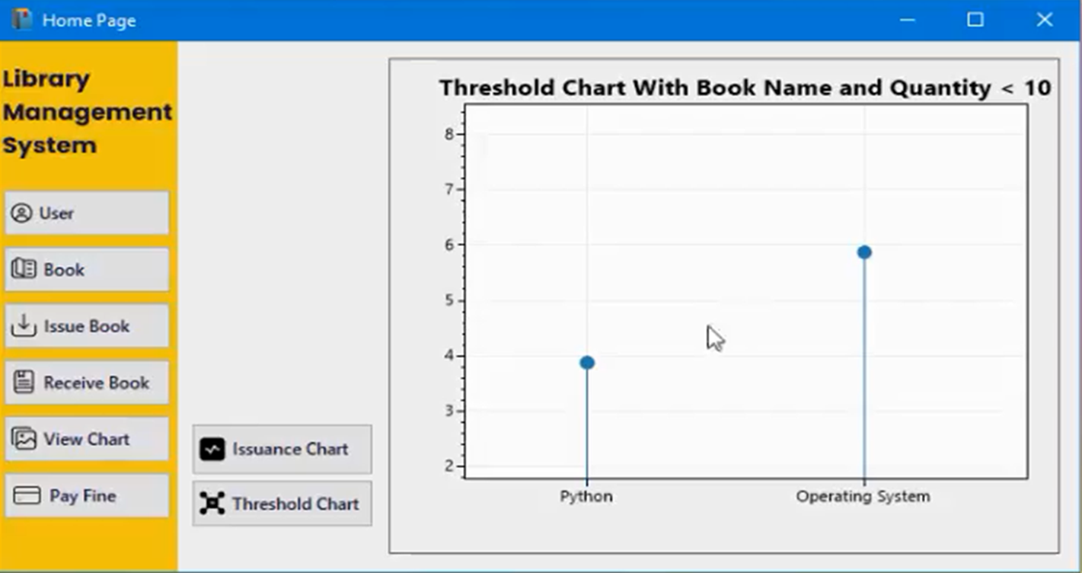
Threshold Chart (Continue..)

Slide 40
Thank You

